Slide 1


Background of SQL
Fundamentals and Background

Slide 2
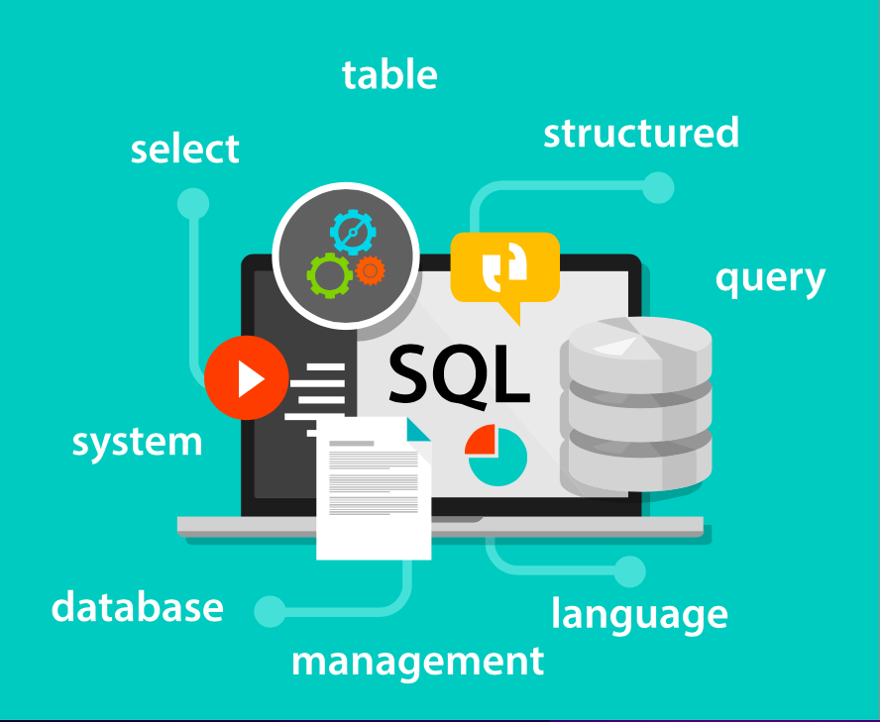
What is SQL?
SQL was developed by IBM researchers in the 1970s.
SQL (Structured Query Language) is a programming language we use to communicate to databases.
Examples are find all users, add a new user and delete a user.
Notes:
SQL was developed by IBM researchers in the 1970s. SQL (Structured Query Language) is a programming language we use to communicate to databases. Examples are find all users, add a new user and delete a user .

Slide 3
SQL Databases
A database is a collection of data.
It is a system of accessing and changing the data.
It is also a computerized data with an accessible interface.
MySQL, SQLite, PostgreSQL, Oracle etc. are all relational databases that use SQL.
It is easy to switch to another database that also uses SQL.
Notes:
A database is a collection of data. It is a system of accessing and changing the data. It is also a computerized data with an accessible interface. MySQL, SQLite, PostgreSQL, Oracle etc. are all relational databases that use SQL. It is easy to switch to another database that also uses SQL.

Slide 4
Benefits of SQL
SQL is easily accessible on many platforms and easy to use.
You can install SQL on a PC, on a MAC, and on Cloud 9.
SQL is used everywhere especially in businesses.
Notes:
SQL is easily accessible on many platforms and easy to use. You can install SQL on a PC, on a MAC, and on Cloud 9. SQL is used everywhere especially in businesses.

